Slide 1
DO NOW: 8 April 2019 Read book if time remains
Voice Lessons: Syntax (on notebook paper today):

Slide 2
Review “How to” Essay Grading Requirements:
Your essay needs to have to following to achieve an A:
Use of punctuation to off-set biting (sarcastic) comments (--because you care)
Uses topic sentences/paragraph organization to point out the different issues
Contrasts within a paragraph
Diction: absolutes like never, always, either/or
Tone: Instructive AND tone shifts from light-hearted to more serious/biting
Speaker is of the group discussed (first-hand knowledge)
Mechanics (no easy mistakes showing no self-editing)

Slide 3
A Review of Ethos, Logos, and Pathos: How should we discuss them?
Ethos: Credibility/Ethics
Logos: Logic
Pathos: Emotion

Slide 4
A Review of Ethos, Logos, and Pathos: How should we discuss them?
Ethos: Credibility (trust in the speaker or sources)/Ethics
Logos: Logic, stats/facts, reasonable structure
Pathos: Emotions

Slide 5
Fallacy Project:
Group Activity
Research two terms for a clear definition and explanation
Locate examples to clarify the term and how to find it
Create a google slide presentation for the class

Slide 6
Fallacies:
Fallacy Term | Group Members
Ad hominem | Micah, Kamar
Begging the Question | Taliyah
Ad populem | Taviyonce, Brim, Sanaa, Damia
Red Herring | Mariyon, Jailyn, Micaeli
Bandwagon | Cassidy, Maddie, Allona
Slippery Slope | Kayla W.
Either/Or (False Dilemma) | Mariyon, Jailyn, Micaeli
Equivocation | Aariyah, Jake
Dogmatism | Aishelle
Fallacy Term: | Group Members
Strawman | Micah, Kamar
Hasty Generalization | Taviyonce, Brim, Sanaa, Damia
Post Hoc | Skylah, Kayla F., Jahday, Amari
A Non Sequitur | Aariyah, Jake
False Authority | John W., Jade
Appeal to Ignorance | Cassidy, Maddie, Allona
Alphabet Soup | Skylah, Kayla F., Jahday, Amari
Scare Tactic | John W., Jade
Faulty Analogy | Deja

Slide 7
Fallacies:
Fallacy Term | Group Members
Ad hominem | Ciyonte, Tashae & Sydney
Begging the Question | Angel, Mason, and Trinity
Ad populem | Gabriella and Destiny
Red Herring | Kieran and Iyianna
Bandwagon | Jalia and Amari
Slippery Slope | Angel, Mason, and Trinity
Either/Or (False Dilemma) | Contrell
Fallacy Term: | Group Members
Strawman | Angel, Mason, and Trinity
Hasty Generalization | Josh
Post Hoc | James
A Non Sequitur | Gabriella and Destiny
False Authority | Kieran and Iyianna
Appeal to Ignorance | Ciyonte, Tashae & Sydney
Alphabet Soup | Ciyonte, Tashae & Sydney

Slide 8
Work Time & Reminders:
“How to” shared with Lear by morning
Finish novel by Friday
Group Project due Wednesday

Slide 9
DO NOW: 9 April 2019
You know the drill. Copy as is and then use proofreader marks to edit. There are 10 errors.
April is national poetry month. Its a time when kids’ can enjoy the fun of vurse. Children’s poet Jack Prelutsky remembers how one of his teachers made him feel that poetry was like liver. “I was told that it was good for me, but I wasnt convinced, Prelutsky said. Years later, he wrote some lines of poetry to go with drawings he maid of imaginary animals. Those lines of poetry become the first of his entertaining poems for children.

Slide 10
Fallacy Project Work Time:
Group Activity
Research two terms for a clear definition and explanation
Locate examples to clarify the term and how to find it
Create a google slide presentation for the class
YOU ARE THE TEACHERS FOR THIS. IF YOU DON’T GET IT, THE CLASS WON’T GET IT.

Slide 11
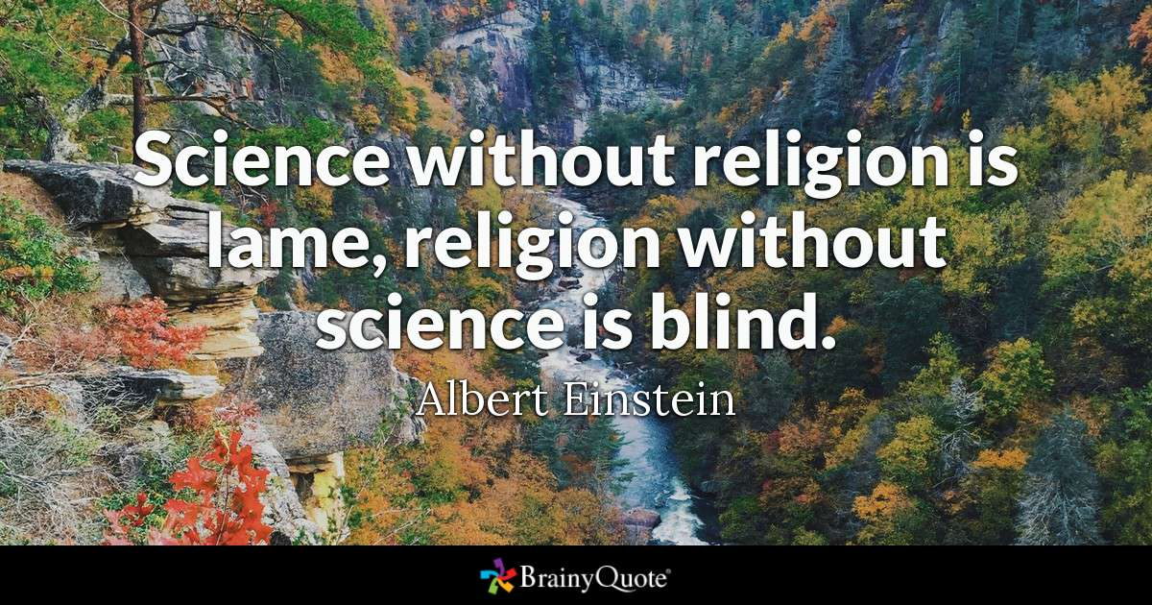
DO NOW: 10 April 2019

Slide 12
Group Presentations:
Presenters: Be loud, proud, and clear. TEACH US!
Audience:
Take notes that make sense to you.
Hold questions for appropriate moments.
Lear will post a class presentation after class if you miss anything.

Slide 13
Extra Time? Read.
Books need to be finished by Friday.
On Friday, you will be asked to write a precis showing understanding of your author’s claim.
TOMORROW:
Fallacy Quiz
Discussion of book project: REHUGO Scrapbook project

Slide 14
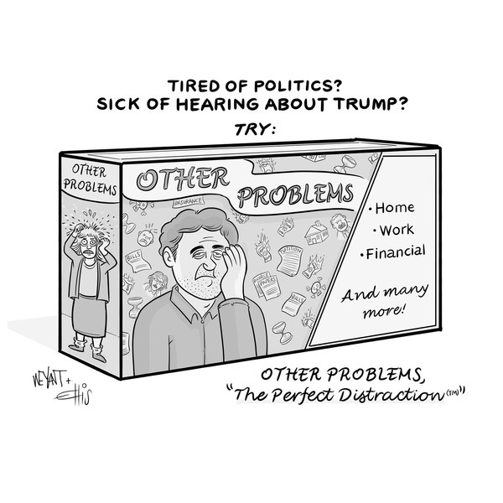
DO NOW: 11 April 2019

Slide 15
Group Presentations:
Presenters: Be loud, proud, and clear. TEACH US!
Audience:
Take notes that make sense to you.
Hold questions for appropriate moments.
Lear will post a class presentation after class if you miss anything.

Slide 16
Extra Time? Read.
Let’s share “How to…”
Use of punctuation to off-set biting (sarcastic) comments (--because you care)
Uses topic sentences/paragraph organization to point out the different issues
Contrasts within a paragraph
Diction: absolutes like never, always, either/or
Tone: Instructive AND tone shifts from light-hearted to more serious/biting
Speaker is of the group discussed (first-hand knowledge)
Mechanics (no easy mistakes showing no self-editing)
TOMORROW:
Fallacy Quiz
Have novel completed tomorrow.
On Friday, you will be asked to write a precis showing understanding of your author’s claim.

