Slide 1
DO NOW: 1 April 2019
Complete Voice Lesson: Imagery.
If you finish early, read your novel.

Slide 2
Jonathan Swift’s “A Modest Proposal”
Review paragraphs 1-12.
Finish reading and completing the reverse outline and SOAPSTone as a class.
Discuss Swift’s purpose.
ET: Write your own individual rhetorical precis for Swift’s satire.

Slide 3
Who is coming on Saturday?
Jailyn
Mariyon
Micaeli
Jake
Kayla W.
John W.
Micah
Kayla F.
Skylah
Contrell
Jaila
Gabriella
Destiny

Slide 4
DO NOW: 2 April 2019
You know the drill. Copy as is and then use proofreader marks to edit. There are 10 errors.
Decorated eggs called pysanky" are a tradition in Ukraine. The craft has been practiced for thousands of year. An artist draw a pattern on an egg with a special pen and hot wax Than she applies dye to the egg. The wax protecks the covered areas from the dye, leaveing blank spaces where other colors can be applyed. She repeats this process to from patterns. The patterns celebrate spring and the easter holiday.

Slide 6
Your Swift Precis
Partner share
Check for the four parts.
Whole class harvesting share
Create a perfect precis

Slide 7
Our 3rd period Exemplar:
Satirical author Jonathan Swift confronts fellow Protestant British imperialists regarding the dehumanizing treatment of poor Irish Catholics in his pamphlet “A Modest Proposal.” Swift first introduces the imagery of the begging poor on the streets of Dublin in order to present the satirical solution of purchasing their one year olds for food and profit. As he engages in the topic using both logos and ethos, he enumerates the many ways British Protestants abuse their power in Ireland. It is clear that Swift’s purpose is to hold a mirror to those British who use Ireland for its resources but never invest in the people or country itself. Jonathan Swift is successful in presenting his tone of sarcasm and satire through the reprehensible and immoral suggestion that the rich should eat babies.

Slide 8
Our 2nd period Exemplar:
Satirist Jonathan Swift, in his pamphlet “A Modest Proposal,” challenges the behavior of fellow Protestant British imperialists towards the Irish Catholic poor. Swift presents his argument by proposing the ridiculous suggestion that the landlords should purchase the tenants’ (poor Irish) babies at age one for food, and he then shows his true suggestions through sarcastic discussion of his plan. Swift engages the reader through a persona intended to mirror his audience of corrupt British colonizers. It is clear through his in-depth discussion that Swift’s purpose is to inform the British of the various ways their behavior is harmful to the natives of and country of Ireland. It is clear through various pointed remarks that Swift is using biting sarcasm to show his intended audience—the Protestant British—that their treatment is akin to eating babies, which is of course a heinous, immoral idea.

Slide 9
Mark Twain, “Advice to Youth”
This too is satire, circa 1882.
Read. Annotate.
* the parts that for sure seem satire (as in Twain says the opposite of what he really means).
Complete SOAPSTone as you read and/or after.

Slide 10
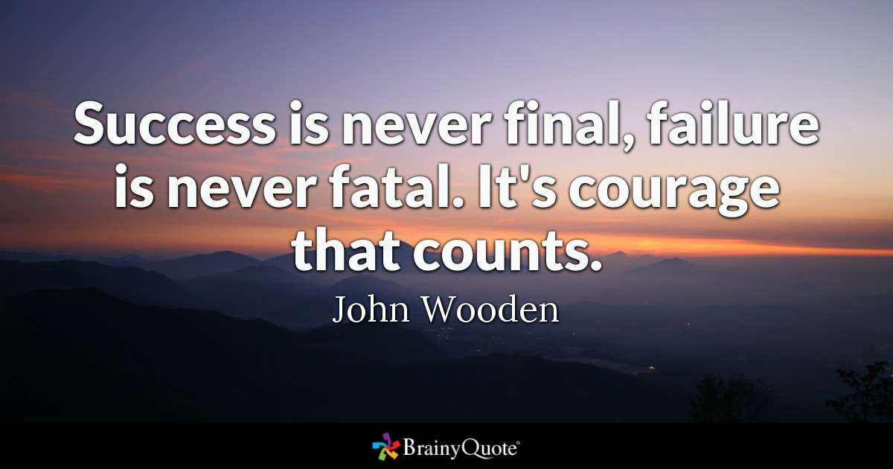
DO NOW: 3 April 2019

Slide 11
Mark Twain, “Advice to Youth”
What are instructions/lessons you are taught growing up?
Discuss Twain’s main claim.

Slide 12
What advice have we received from adults?
Cell phones aren’t good for you.
A closed mouth doesn’t get fed.
Don’t be lazy.
Don’t curse.
Do better, be better.
Roll your eyes again, and I’m gonna…
Don’t get smart with me.
Clean this room or I am going to and I will take everything to Goodwill.
Stop crying or I will give you something to cry about.
Don’t focus on fake energy.
Don’t do work if you are going to suffer consequences anyway.
Stop…
Keep making that face and it will stay that way. (Fix your face)
Treat others the way you want to be treated.
Stop fighting or I am going to turn this car around.
I brought you into this world, and I can take you out.

Slide 13
What is Twain’s real claim?
Ultimately, Twain is arguing in favor of nonconformity.

Slide 14
Advice we have received
Light in car
Don’t talk to strangers
Treat others as you want to be treated
Your friends aren’t your friends
Get a job
Respect your elders
Adults aren’t always right
If you don’t feel comfortable don’t do it
When you assume things, you make an a** out of you and me
Keep making that face, and it will get stuck that way.
That lip is out so far a pigeon is going to sit on it
Don’t let anyone play with your hair
Peer pressure
Don’t do drugs
Once someone shows you their true colors, believe them.
If someone hits you, hit them back.
Use your words
Don’t be the first to use your fists
If you have to use the bathroom, walk out.
Stop crying or I will give you something to cry about
There are people in Africa without food.
You will wake up before 7 for the rest of your life.
If you are going to lie, you better make it a good one so that you won’t have to keep saying it over and over.

Slide 15
Twain’s Claim
Ultimately, Twain wants to discourage conformity.

Slide 16
The Half-Way Point of Your Dystopian Novel
Assuming you are following your reading plan, you are ½ way through (maybe more) your novel.
Complete Journal #2 by end of class.
Read with remaining time.
Just a friendly reminder that there will be a project attached to this book, so you must be able to identify and discuss the claim your author is making.
**NO TALKING. JUST READING AND WRITING.

Slide 17
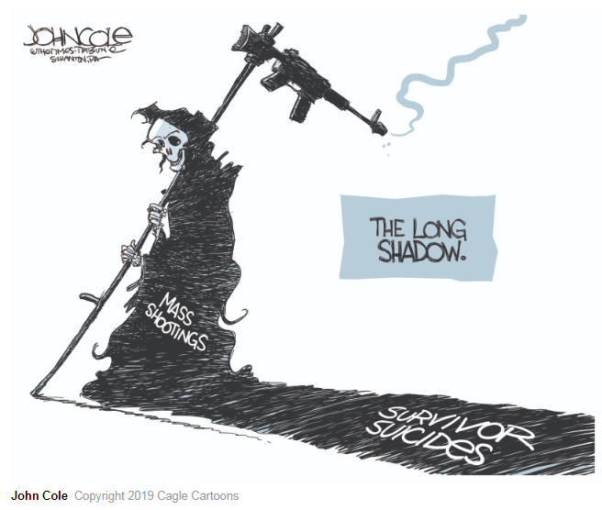
DO NOW: 4 April 2019

Slide 18
Who is coming on Saturday?
Jailyn
Mariyon
Micaeli
Jake
Kayla W.
John W.
Micah
Cassidy
Skylah
Contrell
Jaila
Gabriella
Destiny (maybe)
Amari B.
Jade
Tavioncye

Slide 19
“How to Write about Africa” by Binyavanga Wainaina
Based upon what Wainaina says, how do people/writers generally characterize the place and people of Africa?
What are real descriptions of the continent and people the author exposes through his satire?
What is Binyavanga Wainaina’s argument?
Author Binyavanga Wainaina argues in his satirical piece “How to Write about Africa” that all too often people write about a false “Africa” rather than talking about the multi-dimensional continent with diverse people.
Use of punctuation to off-set biting (sarcastic) comments (--because you care)
Uses topic sentences/paragraph organization to point out the different issues
Contrasts within a paragraph
Diction: absolutes like never, always, either/or
Tone: Instructive AND tone shifts from light-hearted to more serious/biting

Slide 20
“How to Write about Africa” by Binyavanga Wainaina
Based upon what Wainaina says, how do people/writers generally characterize the place and people of Africa?
What are real descriptions of the continent and people the author exposes through his satire?
What is Binyavanga Wainaina’s argument?
Author Binyavanga Wainaina argues in his satire “How to Write about Africa” that people who write about the continent of Africa often sensationalize the bad stuff or romanticize it rather than talk about its real qualities.
Absolutes (diction) Never…Always
Superficial to Complex discussion topics
Biting remarks intertwined, but also set-off via punctuation (--because you care)
Topic sentences that are built upon in the paragraph
Each paragraph is a new topic
Informative tone which becomes “snarkier” as it builds

Slide 21
Prior Thoughts
Jungle and animals
Heritage—”Motherland,” ancestors
Continent (shape)
Black people
Money—diamonds and gold
Hunger
Clothing—tribal attire
Music and dance—percussion in particular
Sierra Leone
Hair wraps/scarves
Language
Natural
Soccer

Slide 22
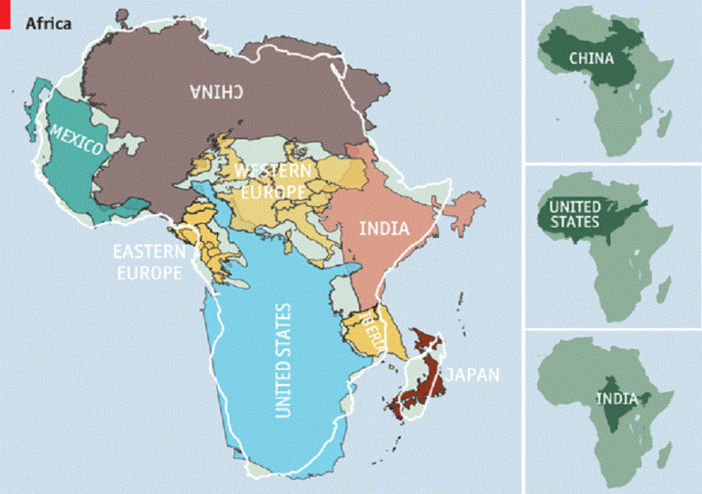

Slide 23
Prior Thoughts
Gold, diamonds
Resources are depleted
“Motherland”
Poor people on commercials—”poverty porn”
Or is it the richest country?
Are there white people there? A lot in South Africa
Elephants? Animals? Ivory hunting
Heard some accents
Strong culture
Cheetahs-extinction
Africa=Continent

Slide 24
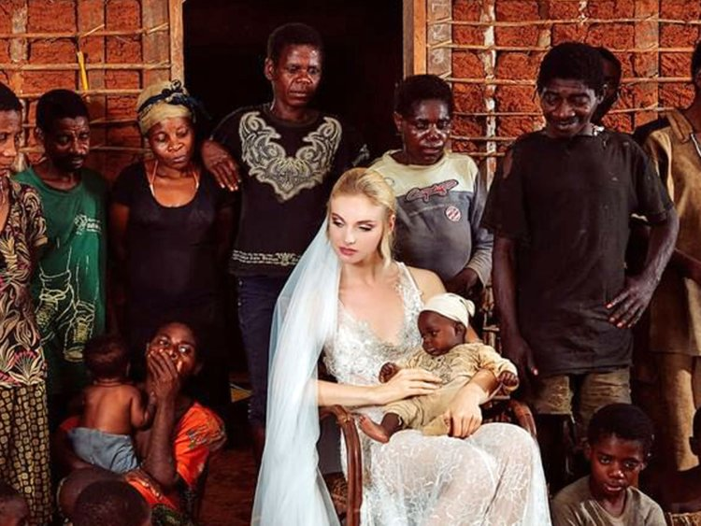
What do you think?

Slide 25
Friday’s Assignment:
Using Binyavanga Wainaina’s “How to Write about Africa” as a mentor text, write your own “How to Write (Talk) about […]” essay.
It should be one page minimum (TYPED) and should follow the structure of our mentor text.
Share on google docs to geri.lear@ekhs.org NO LATER THAN TUESDAY, APRIL 9.

