Slide 1
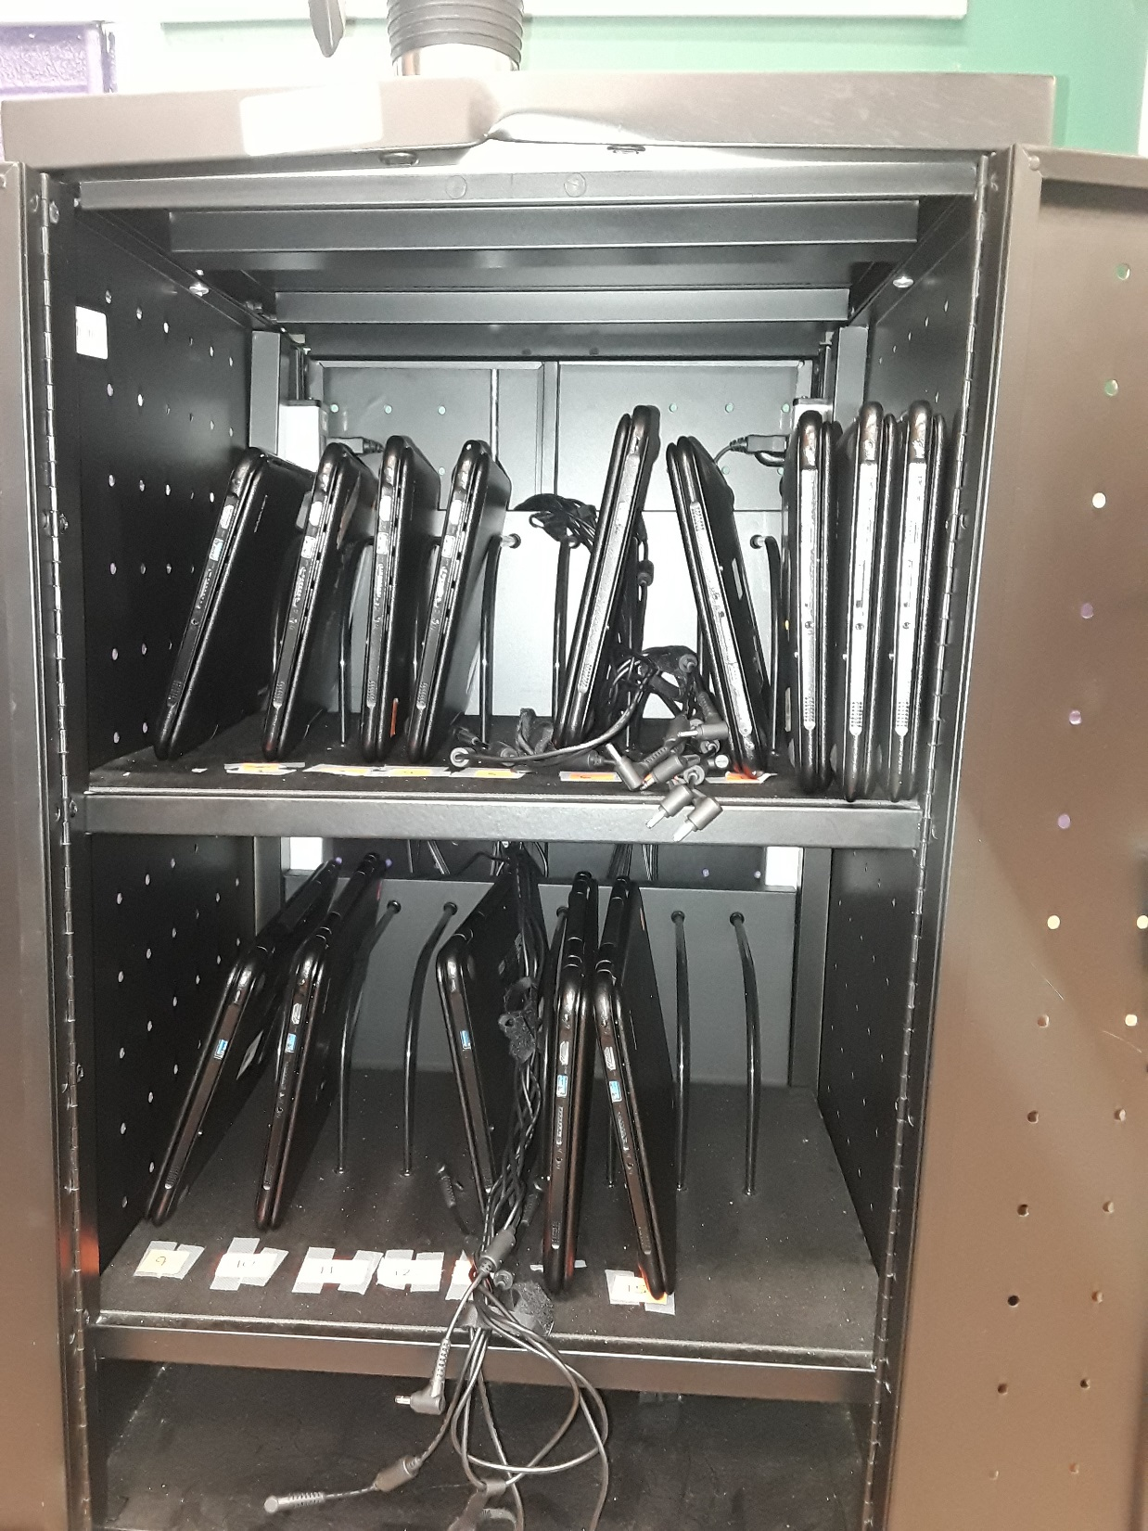
DO NOW: 26 March 2019
Visual Analysis Tuesday:
**Put all work from yesterday in basket NOW.
What’s wrong with this picture?
Did you use this cart yesterday?
How did you leave your laptop?
Why do you think this cart looks like this?

Slide 2
Commentary of Precis Practice
Now that most seem to get it, develop into more.
For sentence 1, don’t forget credentials.
For sentence 2, be more specific than “ethos” etc.
For sentence 4, make it seem finished and be aware of connotation of word choice.

Slide 3
Dave Barry, “Turkeys in the Kitchen”
P. 72
Compare to Judy Brady’s “I Want a Wife”
Rhetorical precis review

Slide 4
Novel Reading Time
You must have at least half of your book finished by Friday.

Slide 5
DO NOW: 27 March 2019
Analyze the quote and the argument therein:
“Satire is, by definition, offensive. It is meant to make us feel uncomfortable. It is meant to make us scratch our heads, think, do a double-take, and then think again.”
~ Maajid Nawaz
Read your book if you finish early.

Slide 6
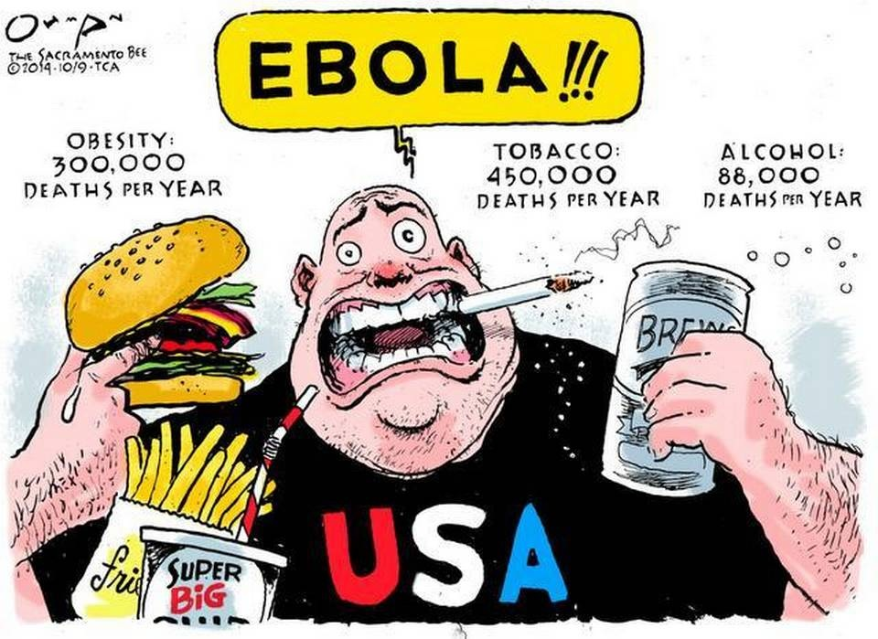
DO NOW: 28 March 2019

Slide 7
Jonathan Swift, “A Modest Proposal”
Read and analyze
P. 701 in The Bedford Reader
Complete the three-part chart

Slide 8
DO NOW: 29 March 2019
Free Write Friday.
Silent thinking and writing for 10 minutes.

Slide 9
Novel Reading Time
You must have at least half of your book finished by Friday.

