Slide 1
DO NOW: 4 February 2019
Voice Lesson vs. “Details”
Complete the page with focus on author detail selection.
When you are finished, please read.

Slide 2
Their Eyes Were Watching God
Tie it all together. See all the parts working to make you see _________________________________.
Pick a strategy to focus on for your essay.
Complete the book by Friday.

Slide 3
Reading Time/Conferencing

Slide 4
DO NOW: 5 February 2019
Complete Rule 2, 3, and 4 in your “SAT/ACT Grammar” Packet.
Actually complete the practice sets (there are 5 questions per rule).
Read with time remaining.

Slide 5
Their Eyes Were Watching God
Tie it all together. See all the parts working to make you see _________________________________.
Pick a strategy to focus on for your essay.
Complete the book by Friday.

Slide 6
Reading Time/Conferencing

Slide 7
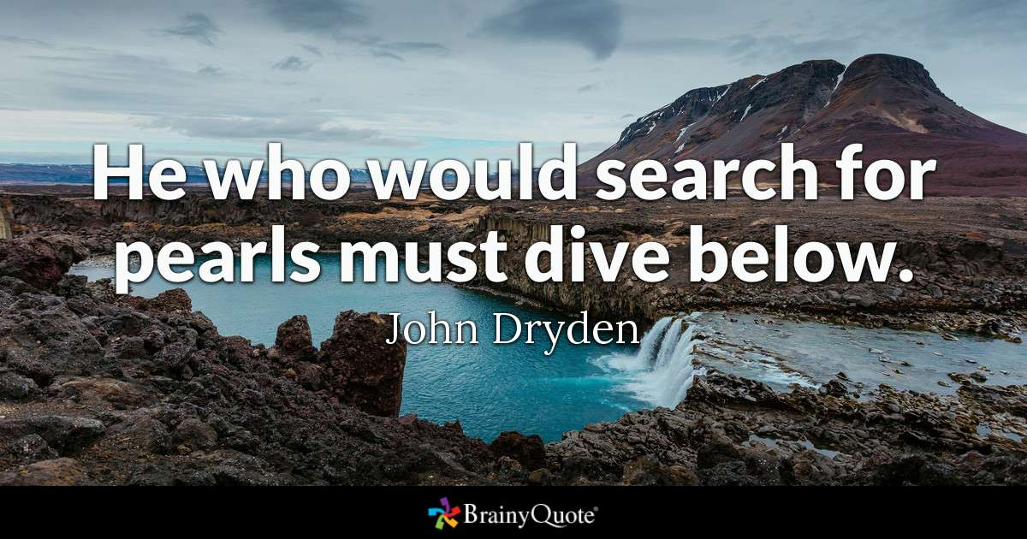
DO NOW: 6 February 2019

Slide 8
As you finish, any questions?

Slide 9
Round Table Reading & Discussion
Bedford Reader
p. 477, Marie Javdani “On Writing”
p. 360, Judy Brady, “I Want a Wife”
Discuss as a mentor text
Writing Assignment…Due Friday (there will be work time tomorrow)
Write like Brady to create an essay like hers on a different topic.
What are some topic options that could work?
Male vs. female
Single parent
Student vs. teacher
Fake Friend vs. Real friend
Millenials vs. other generation (old vs young)
Child-parent
Boyfriend-girlfriend
Sibling expectations
Sister(daughter) v. brother (son)
Oldest v youngest
White male/female vs. black male/female

Slide 10
Student-teacher
Child-parent
Boyfriend-girlfriend
Male-female
Sibling expectations
Sister(daughter) v. brother (son)
Oldest v youngest

Slide 11
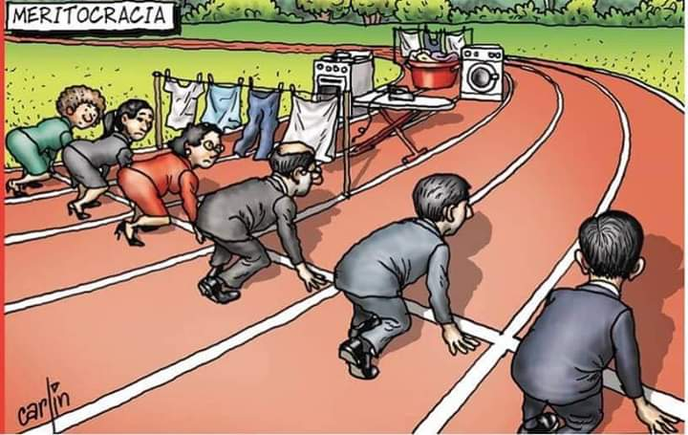
DO NOW: 7 February 2019

Slide 12
Work Time
Writing Assignment…Due Friday
Write like Brady to create an essay like hers on a different topic.
Organization: simple tasks to more intense differences
Ended with a question that she is answering from paragraph 2
Emphasis via italics on words
Tone of sarcasm/antagonism:
Details/scenarios
Word choice
Exaggeration
Anaphora (parallelism/repetition) “I want a wife…”
Para. 1: Introduces speaker (persona)
Para. 2: Establishes occasion
Concludes with “Who wouldn’t want a wife?”
What are some topic options that could work?
Male vs. female
Single parent
Student vs. teacher
Fake Friend vs. Real friend
Millennials vs. other generation (old vs young)
Child-parent
Boyfriend-girlfriend
Sibling expectations
Sister(daughter) v. brother (son)
Oldest v youngest
White male/female vs. black male/female

Slide 13
Work Time
Writing Assignment…Due Friday
Write like Brady to create an essay like hers on a different topic.
Anaphora (parallelism/repetition) of “I want a wife”
Helped with tone of sarcasm
Organized simple (least offensive) to complicated
Intro: self and role (creating ethos)
Sarcasm conclusion: “Who wouldn’t want a wife?”
Intro present occasion:
Because male friend got divorced and was looking for another wife.
What are some topic options that could work?
Male vs. female
Single parent
Student vs. teacher
Fake Friend vs. Real friend
Millennials vs. other generation (old vs young)
Child-parent
Boyfriend-girlfriend
Sibling expectations
Sister(daughter) v. brother (son)
Oldest v youngest
White male/female vs. black male/female

