Slide 1
DO NOW: 28 January 2019
Complete Voice Lesson worksheet on Diction.
15 minutes
Brainstorm for “Apply”:
naloxone, an opioid antagonist
Anesthesia
Surgery
Abrasion
Oxygen
Fracture
CPR
Revive

Slide 2
DO NOW: 28 January 2019
Complete Voice Lesson worksheet on Diction.
15 minutes
Brainstorm “medical terms” together
Therapy
Remedy
Medication
Keep reading TEWWG if you finish early.

Slide 3
Rhetorical Analysis, part I
Paper return and binder organization (5 minutes)
Reflect on Lear’s feedback on your diagnostic rhetorical analysis essay.
Use the rubric in AP Resource Packet to help with score understanding.

Slide 4
Rhetorical Analysis, part II
Read the Chavez letter from the 2015 exam
Annotate for the rhetorical choices
Discuss what we each saw as a rhetorical choice:
Line 27-30: Talking about “people” overall; use of collective pronouns; 42-44 talks about what people do when…; “our people” (line 45-46); 79-81 “people.”=1) acknowledging his audience bringing them to his side; 2) bandwagon appeal
Repetition of powerful words that impact his point=“militant nonviolence”
Line 74 “Violence does not work in the long run”= Logical, thought-out
Ethos: makes his argument more credible by referencing MLK, Jr. and Gandhi

Slide 5
Rhetorical Analysis, part II
Read the Chavez letter from the 2015 exam
Annotate for the rhetorical choices
Discuss what we each saw as a rhetorical choice:
Argument of bandwagon appeal- if you are for these violent things, you are a problem.
Use of ‘violence’ and what it is, “if you …”
Nonviolence vs. violence
Positive language (“support”; “solution”; justice; strength)= nonviolence
Guilt with choosing violence=peer pressure
Everyone, “people”
Violence does….
Ethos appeal- Gandhi and MLK, Jr., history
If/then organization

Slide 6
Extra Time?
Read TEWWG, Ch. 4-10, by Friday.
Begin the SAT/ACT Grammar review packet:
Rule 1: Subject-Verb Agreement

Slide 7
DO NOW: 29 January 2019
Review Subject-Verb Agreement from yesterday’s packet.
1.
2.
3.
4.
5.
Period 3: Read and/or work on Rule 2: Verb Tense until my return.

Slide 8
Answers and discussion
Review Subject-Verb Agreement from yesterday’s packet.
1. C
2. B
3. D
4. B
5. A

Slide 9
Rhetorical Analysis, part III
Read, review, and reflect on the scored sample responses.
Exit Ticket:
What did the students do that you already do?
What did the students do that you can try to do now that you see that option?
What do you need to learn moving forward so that you can complete a successful rhetorical analysis essay?
We will write another practice essay on Thursday.

Slide 10
Extra Time?
Read TEWWG, Ch. 4-10, by Friday.
Begin the SAT/ACT Grammar review packet:
Rule 2: Verb Tense

Slide 11
DO NOW: 30 January 2019

Slide 12
Reading Rhetorically
Apply DO NOW quote
Powerpoint review:
Take some notes
Review Rhetorical Word Lists in AP Resource Packet

Slide 13
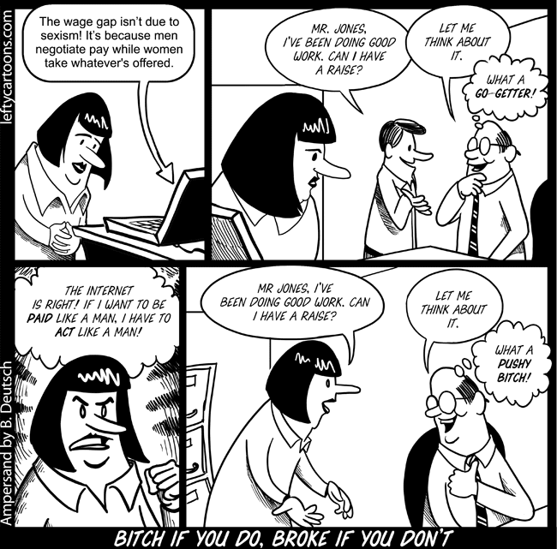
DO NOW: 31 January 2019
Analyze the argument.

Slide 14
Analyzing Hurston’s Style
Look for a piece of text that is “appropriate and convincing” from Hurston’s novel on the assigned topic:
Hair
Dreams
Tree
Men vs. Women
Marriage
Expectation or social obligation
Road/gate
Lamp/light
Community as a character
Janie
Mule
Power of three

Slide 15
Analyzing Hurston’s Style: p. 1-2: Community of Eatonville as a Character
Word/Phrase | Technique | Impact
The sun was gone but he had left his footprints in the sky. | Personification
It was the time for sitting on porches […] It was the time to hear things and talk […] | Repetition via parallelism
These sitters had been tongueless, earless, eyeless […] | Parallel structure
They became lords of sounds and lesser things. They passed nations through their mouths. | hyperbole
[…]they chewed up the back parts of their minds and swallowed with relish. | metaphor | The metaphor of making the words seem like implements of substance, of violence, makes it clear to the reader that words matter in this community.

Slide 16
Preparation for Practice Essay
Read and annotate your 2006 rhetorical analysis essay passage.
Write your thesis statement at the bottom of the page.
Turn in.
Tomorrow we will write the essay in 40 minutes after our Socratic seminar.
***Don’t forget to have your questions and chapters completed.

Slide 17
Homework:
Write five questions using Bloom’s taxonomy for Friday’s Socratic Seminar
Finish Ch. 4-10

Slide 18
DO NOW: 1 February 2019
Free Write:
5 minutes of SILENT writing and thinking
Have your 5 questions on your desk for homework check.

Slide 19
Rhetorical Analysis Essay—40 minutes.
Quickly review your passage from yesterday and your thesis statement.
Write the essay with consideration of all we have added to your understanding of “rhetorical analysis.”
If you finish early, turn in with passage AND continue reading and/or preparing for our Socratic seminar.

Slide 20
Socratic Seminar: TEWWG, ch. 1-10
Reminders:
Contribution and quality of contribution matters.
You can still earn a ‘B’ if you write a one page reflection on the discussion and your thoughts about the conversation.
You will turn in your questions.
Jot down your thought to not forget if it is taking time to get to you.
LISTEN. We don’t have time for repetition.

